Slide 1



Leveraging Predictive Modeling to Detect and Prevent Healthcare Claims Fraud
PROJECT GUIDE
Ms.P.JAYADHARSHINI
PROJECT MEMBER
SUDHARSHAN S 22ALR097
RITHANYA M 22ALR080
SUDHEKSHA K 22ALR099

Slide 2
PROBLEM STATEMENT
Fraudulent activities within healthcare claims result in substantial financial losses and undermine the integrity of the healthcare system. Existing methods to detect such fraud are often reactive rather than proactive. This project aims to build a predictive model using historical healthcare claims data to identify patterns of fraudulent behavior and prevent fraudulent claims before payments are made.

Slide 3
DATASET
https://www.kaggle.com/datasets/rohitrox/healthcare-provider-fraud-detection-analysis
DATASET DESCRIPTION
The "Healthcare Provider Fraud Detection Analysis" dataset is designed to identify fraudulent activities in healthcare claims. It contains multiple CSV files, including data on beneficiaries, inpatient and outpatient services, and associated claims. The dataset includes detailed attributes such as patient demographics, provider details, and claim specifics, like diagnosis, treatment codes, and billing information. This dataset is typically used for building machine learning models to detect fraudulent claims by analyzing patterns, anomalies, and inconsistencies in the healthcare service usage data across different providers and beneficiaries.

Slide 4
File Name | Description | Key Attributes
Train-1542865627584.csv | Main training dataset containing healthcare provider claim details for fraud detection analysis. | Claim ID, Provider ID, Date, Claim Amount, Fraud Label
Test-1542969243754.csv | Main testing dataset containing claim data for model evaluation. | Claim ID, Provider ID, Date, Claim Amount, Fraud Prediction
Train_Beneficiarydata-1542865627584.csv | Supplementary training dataset containing patient demographic information. | Beneficiary ID, Age, Gender, Chronic Conditions
Test_Beneficiarydata-1542969243754.csv | Supplementary testing dataset containing patient demographic information. | Beneficiary ID, Age, Gender, Chronic Conditions
Train_Inpatientdata-1542865627584.csv | Training dataset containing data on inpatient services provided. | Admission Date, Discharge Date, Diagnosis Codes, Procedure Codes
Test_Inpatientdata-1542969243754.csv | Testing dataset containing data on inpatient services provided. | Admission Date, Discharge Date, Diagnosis Codes, Procedure Codes
Train_Outpatientdata-1542865627584.csv | Training dataset containing data on outpatient services provided. | Visit Date, Diagnosis Codes, Procedure Codes
Test_Outpatientdata-1542969243754.csv | Testing dataset containing data on outpatient services provided. | Visit Date, Diagnosis Codes, Procedure Codes

Slide 5
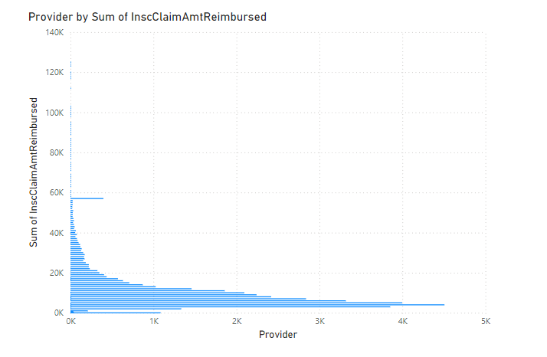
QUESTIONS
1) What is the total reimbursement amount per provider?

Slide 6
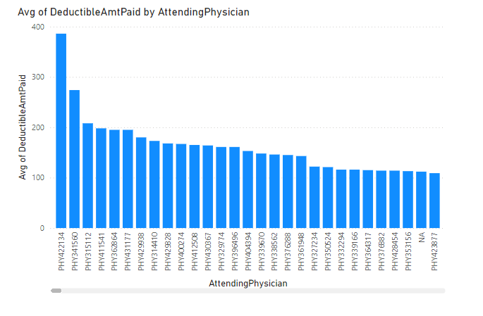
2) What is the average deductible amount paid by claim per attending physician?

Slide 7
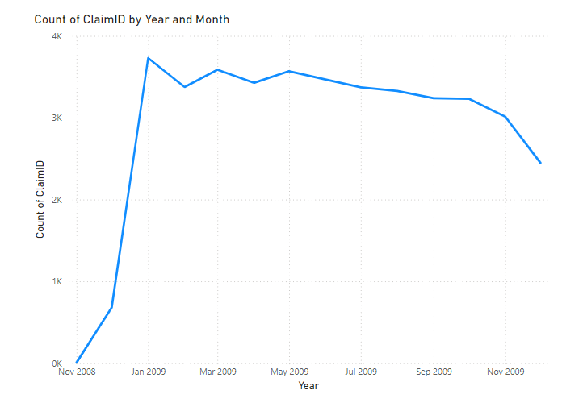
3) How does the number of claims vary by admission year and month?

Slide 8
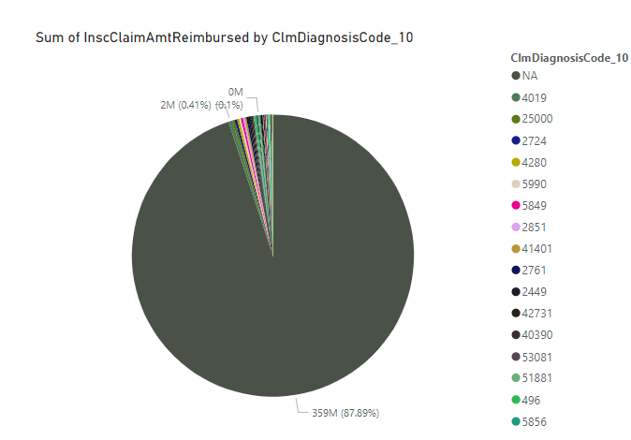
4) What is the total reimbursed amount per diaClmDiagnosisCodes?

Slide 9
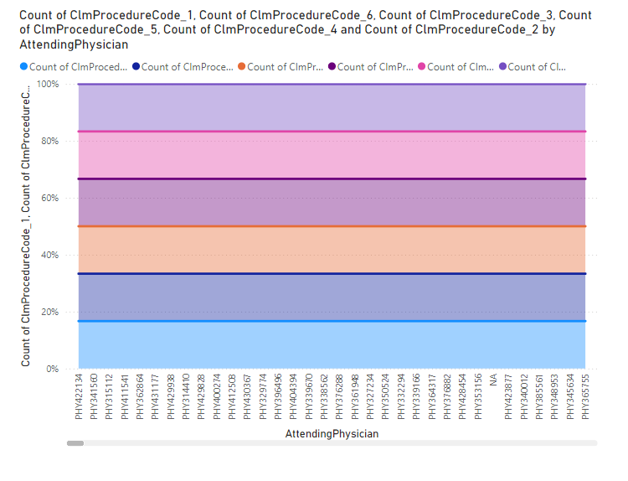
5) How does the number of procedures per claim vary across different attending physicians?

Slide 10
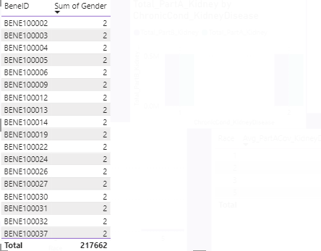
6) What is the distribution of gender in the dataset? DAX QUERY: GenderCount = COUNTROWS('Train_Beneficiarydata-1542865627584')

Slide 11
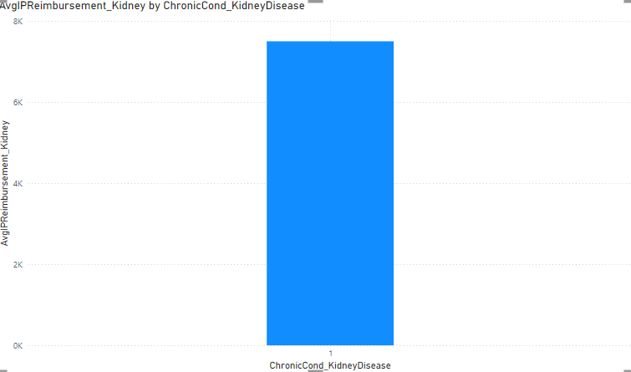
7) How does the presence of chronic kidney disease affect inpatient reimbursements? DAX QUERY:AvgIPReimbursement_Kidney = AVERAGEX(FILTER('Train_Beneficiarydata-1542865627584','Train_Beneficiarydata-1542865627584'[ChronicCond_KidneyDisease] = 1), 'Train_Beneficiarydata-1542865627584'[IPAnnualReimbursementAmt])

Slide 12
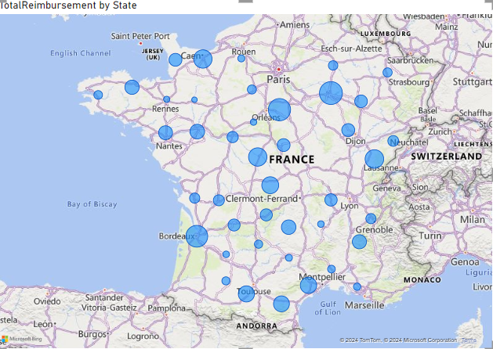
8)Which state has the highest inpatient and outpatient reimbursements? DAX QUERY:TotalReimbursement = SUM('Train_Beneficiarydata-1542865627584'[IPAnnualReimbursementAmt]) + S('Train_Beneficiarydata-1542865627584'[OPAnnualReimbursementAmt])

Slide 13
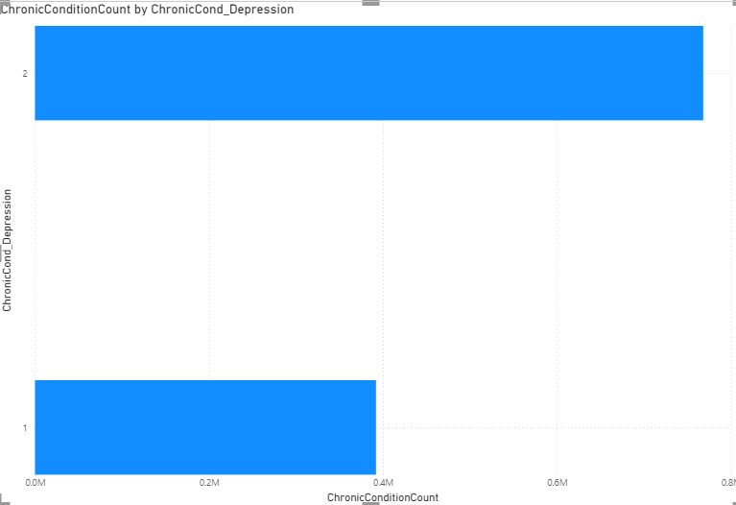
9) What is the impact of depression on outpatient reimbursements? DAX QUERY:AvgOPReimbursement_Depression = AVERAGEX(FILTER('Train_Beneficiarydata-1542865627584', 'Train_Beneficiarydata-1542865627584'[ChronicCond_Depression] = 1),'Train_Beneficiarydata-1542865627584'[OPAnnualReimbursementAmt])

Slide 14
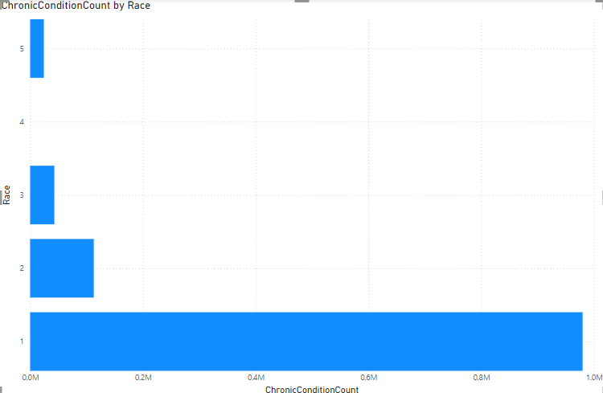
10) Which races are more prone to chronic conditions? DAX QUERY:ChronicConditionCount = SUMX('Train_Beneficiarydata-1542865627584','Train_Beneficiarydata-1542865627584'[ChronicCond_Alzheimer] + 'Train_Beneficiarydata-1542865627584'[ChronicCond_Heartfailure] + 'Train_Beneficiarydata-1542865627584'[ChronicCond_Cancer] + 'Train_Beneficiarydata-1542865627584'[ChronicCond_Diabetes]+'Train_Beneficiarydata-1542865627584'[ChronicCond_stroke])

Slide 15
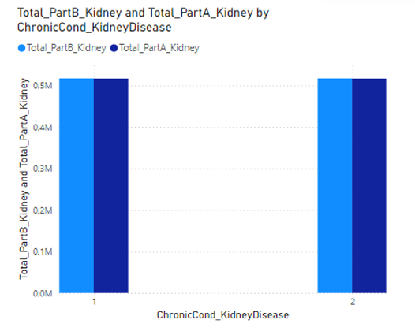
11.What is the total number of months covered by Part A and Part B for individuals diagnosed with chronic kidney disease? DAX QUERY: Total_PartA_Kidney = CALCULATE(SUM('Dataset'[NoOfMonths_PartACov]), 'Dataset'[ChronicCond_KidneyDisease] = 1) DAX QUERY: Total_PartB_Kidney = CALCULATE(SUM('Dataset'[NoOfMonths_PartBCov]), 'Dataset'[ChronicCond_KidneyDisease] = 1)

Slide 16
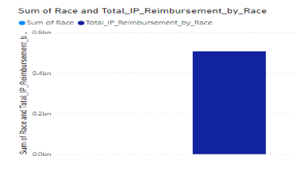
12. How much is the total reimbursement amount for inpatient (IP) care by race? DAX QUERY: Total_IP_Reimbursement_by_Race = CALCULATE(SUM('Dataset'[IPAnnualReimbursementAmt]), ALLEXCEPT('Dataset', 'Dataset'[Race]))

Slide 17
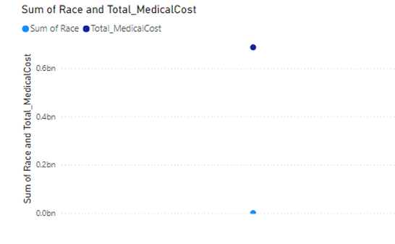
13.What is the correlation between Chronic Conditions (e.g., Alzheimer's, Heart Failure, Kidney Disease) and total medical costs (IP + OP Annual Reimbursement) across different races?

Slide 18
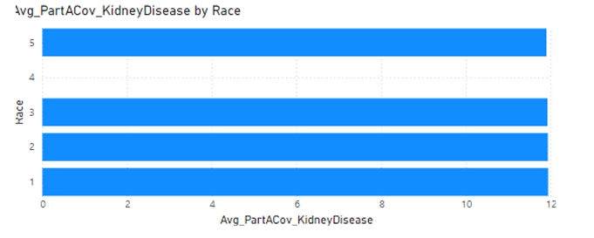
14.What is the average number of months of Part A coverage for individuals with chronic kidney disease, segmented by race? DAX QUERY: Avg_PartACov_KidneyDisease = CALCULATE( AVERAGE('Dataset'[NoOfMonths_PartACov]), 'Dataset'[ChronicCond_KidneyDisease] = 1 )

Slide 19
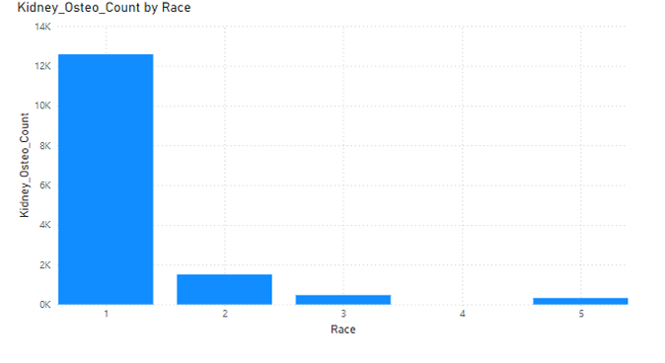
15.What is the distribution of individuals with different races who have both Kidney Disease and Osteoporosis as chronic conditions? DAX QUERY: Kidney_Osteo_Count = CALCULATE( COUNTROWS('Dataset'), 'Dataset'[ChronicCond_KidneyDisease] = 1, 'Dataset'[ChronicCond_Osteoporasis] = 1 )

Slide 20
THANK YOU

